Slide 1

Improving user retention and engagement

Slide 2
Metric Definition
Metric: Weekly Retention Rate
Definition: the proportion of users who log-in to the app at least once on the ‘Nth’ week after creating an account
Calculation:
For each user, calculate the number of weeks between active_date (log-in date) and created_at (signup date)
If there is at least one logging activity for a certain week, then the user is considered as retained for that specific week
Calculate the proportion of users retained for a certain week (‘Nth week’) out of the total number of users who created an account
Reasons of Selection :
The selection of retention metric is based on the frequency with which we expect people to use the product
We expect users to come regularly to the product to get information and advice on their financial situation. Users are likely to visit the app on a weekly basis or a couple of times in a month.
Measuring retention rate on a daily basis will be too frequent to gain useful information and measuring on a monthly basis will be too sparse to understand the variation of user behavior. Hence, weekly retention rate is a better indicator of the product health as it is more aligned with how frequently users naturally come back

Slide 3
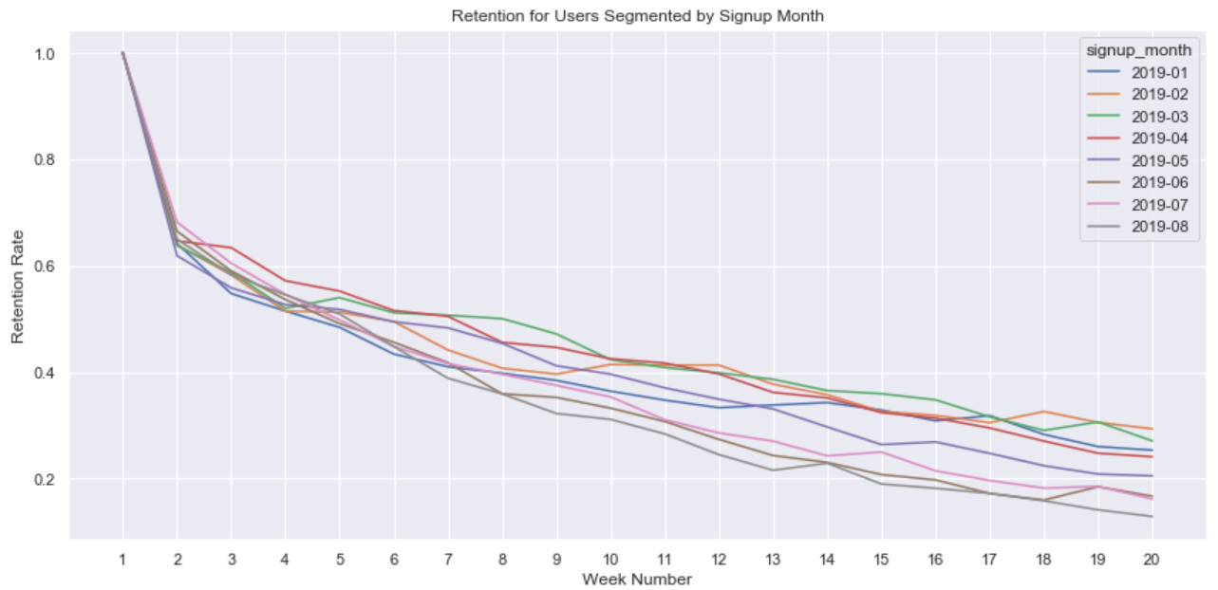
Retention For Users Segmented by Signup Month
The biggest drop in user retention happens in the second week after sign-up. Will address how to improve retention rate in the following slides
Assigning all customers to 8 cohorts based on their signup month, users who signed up more recently (from June to August) have lower long-term retention compare to these who signed up from Jan to March. More investigation to be done to understand what attributes (e.g. marketing campaign, promotion event, user composition) do these early sign-up cohorts share might be causing them to stick around and what are the internal and external factors(e.g. competitors) leading to recent users to leave

Slide 4
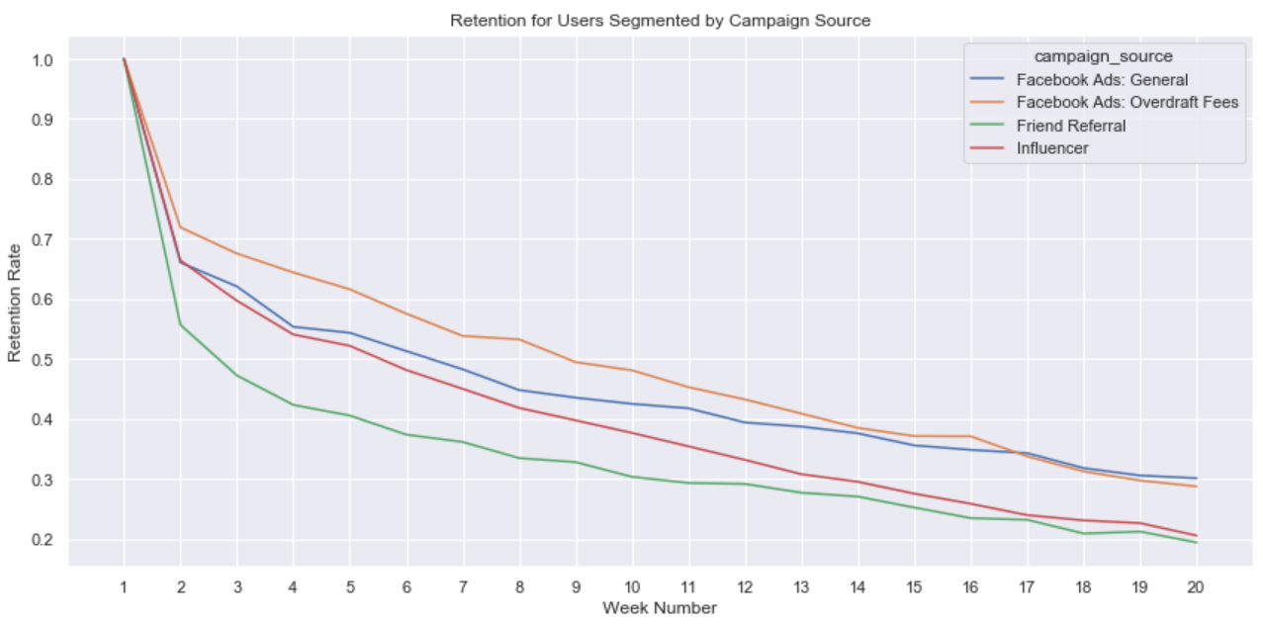
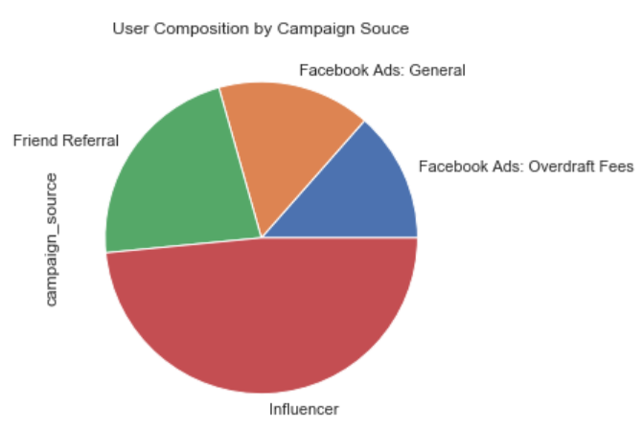
Retention For Users Segmented by Campaign Source
While influencer is the biggest campaign source of users acquisition, its long-term retention rate is lower compared to Facebook ads, particularly FB ads: overdraft fees. Friend Referral has the lowest retention rate across all the campaign sources. One assumption is that friend referral is more likely to attract users who are more interested in the referral reward instead of having genuine interest in using the product
To improve both short-term and long-term retention, I would recommend 1) evaluate the ROI of each campaign source and adjust campaign budget, potentially by increasing the budget on FB campaign, especially overdraft fees campaign 2) re-evaluate the referral program and adjust referral reward if necessary

Slide 5
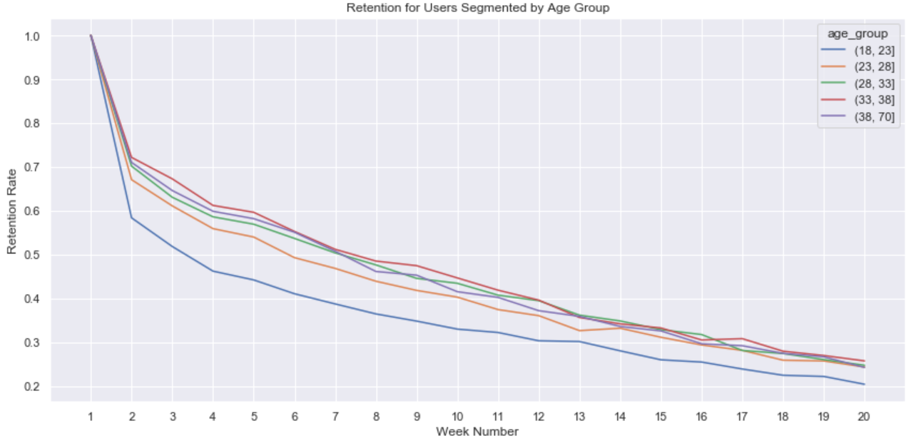
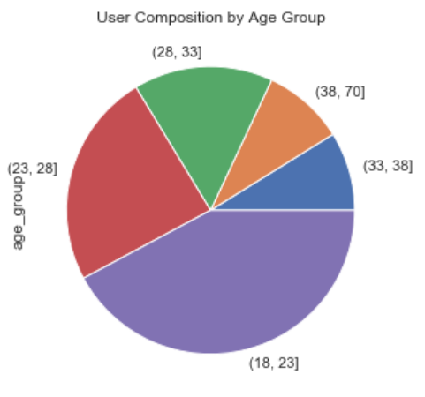
Retention For Users Segmented by Age Group
The majority of users are between 18-28 years old. However, age in general tends to have a positive relationship with retention rate. Users aged 28 or more have higher retention rate than younger users. It will drive user retention by shifting the user age distribution be to more balanced across various age groups. This can be achieved through targeting more on older groups when running marketing campaign

Slide 6
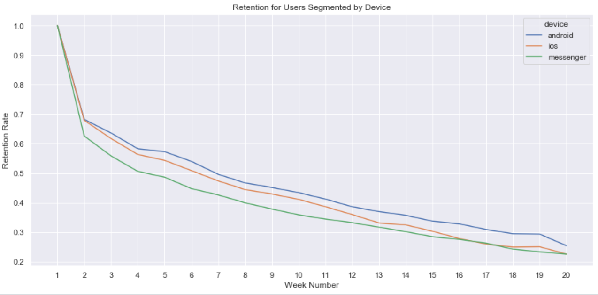
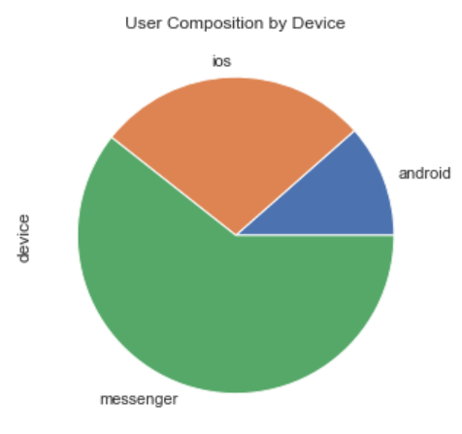
Retention For Users Segmented by Device
The majority of users using the app through messenger. It is also where we see the lowest retention both for short-term and long term. I will recommend to look more closely at behavior across these three platforms and see what about the user experience could be improved to get messenger users retention levels to match the others

Slide 7
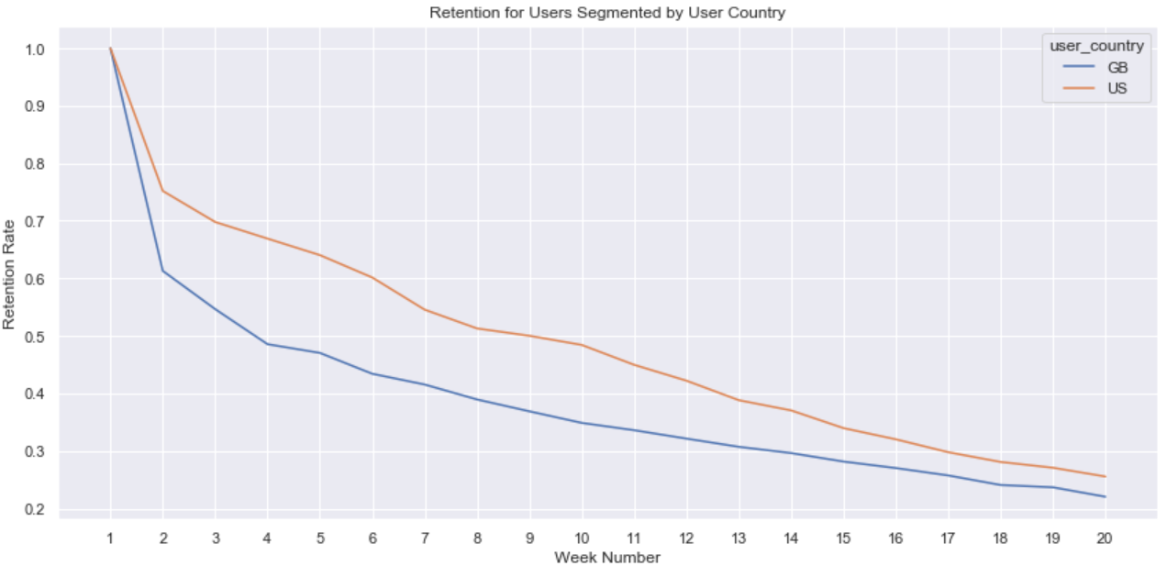
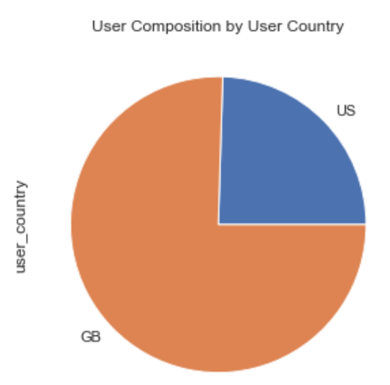
Retention For Users Segmented by User Country
American users have significantly higher retention (particularly short-term retention) compared to British users. Shifting the team’s focus more towards US market will likely to improve retention rate. However, to fully understand the root cause of the differences, it is worth to explore further on user composition, user behavior and market competitor landscape of these two markets

Slide 8
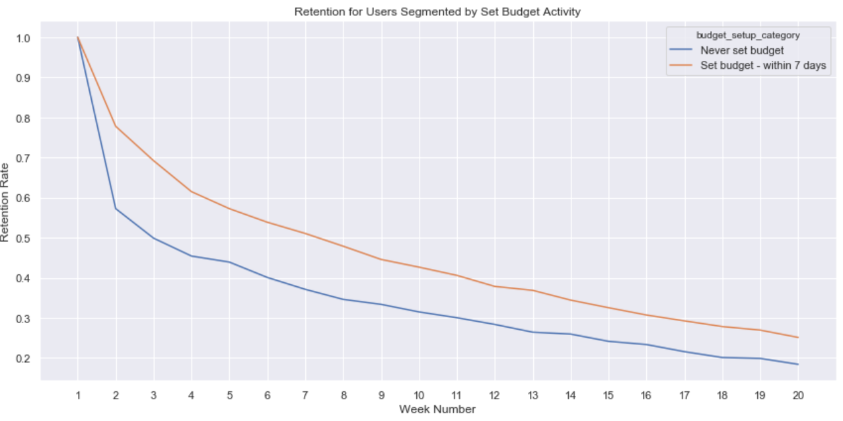
Retention For Users Segmented by Set Budget Activity
Setting budget is a critical event as users explore the app. The graph shows that the retention rate of users who set budget within the first 7 days after sign-up vs these who never set budget
Users who set budget within the first 7 days have a significant higher retention rate. This indicates that setting budget will lift up users retention by giving the incentive to interact with the app on a regular basis
To drive more new users to adopt the budget set function, we can send personalized emails and a couple of push notifications within the first 7 days to introduce this function or give some cash incentive to attract users to try it out
Note: ~75% of users who set up budget did it in the first 7 days after sign-up

Slide 9
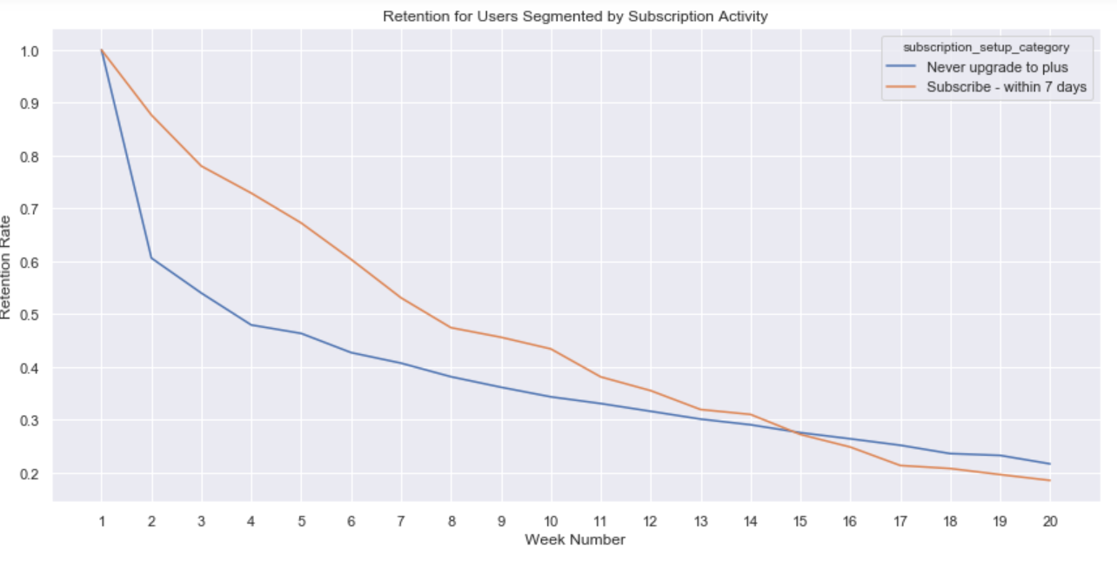
Retention For Users Segmented by Subscription Activity
As a revenue source, subscription activity is essential to the product’ growth. In this graph, it shows the retention rate of users who upgraded to plus within the first 7 days after sign-up vs these who never upgraded
Users who upgraded to plus within the first 7 days have a significant higher short-term retention. However, in the long-term, we see the retention rate of this cohort dropped more rapidly compared to these who never opt-in to plus
This indicates that people who tried with plus at the beginning may find it doesn’t match their expectation after using it for a while, which leads to lower user satisfaction in the long term. We need to conduct further investigation on the user experience of plus and act accordingly
Note: ~50% of users who upgrade to plus did it in the first 7 days after sign-up

Slide 10
Further Analysis
In the previous analysis, I have segmented the retention curves using various user properties – campaign source, age group, device, user country, set budget activity and subscription activity – to understand how each segment is doing and give recommendations accordingly to address opportunities and also raise some questions requiring further investigation. To gain more clarification on the topic, here are a couple of areas for further research:
On boarding experience: retention rate dropped sharply in the first two weeks, which can be potentially caused by bad onboarding experience. Further analysis to be done to understand the onboarding experience – conversion rate of each step, how long each step takes, etc. Also, user survey and qualitative approach such as user interview can be useful here to provide additional context
Experiment on product changes and marketing campaigns: in the previous analysis, I recommended to send personalized emails and a couple of push notifications within the first 7 days to introduce the set budget function or give some cash incentive to attract users to try it out. To understand whether these changes will drive user retention as expected, it is necessary to run A/B testing on randomized users
Regression Analysis: in the exploratory analysis, there are a lot of confounders that make it hard to draw solid conclusion. Running regression analysis (such as logistic regression) by including confounding variables will allow the analysis to control them and understand the relationship between user properties and retention rate
User Segmentation: breaking out user base into current user, new user, resurrected user and dormant users will help to find customized solution to retain each type of users. Another way to segment users is through K-mean clustering to allocate users to various cluster based the actions users take and how frequently they take them, such as clustering users to power, core and passive users.

